Slide 1
National Reading and Math Test Scores Analysis
By Alexander Welsh
12/4/2025

Slide 2
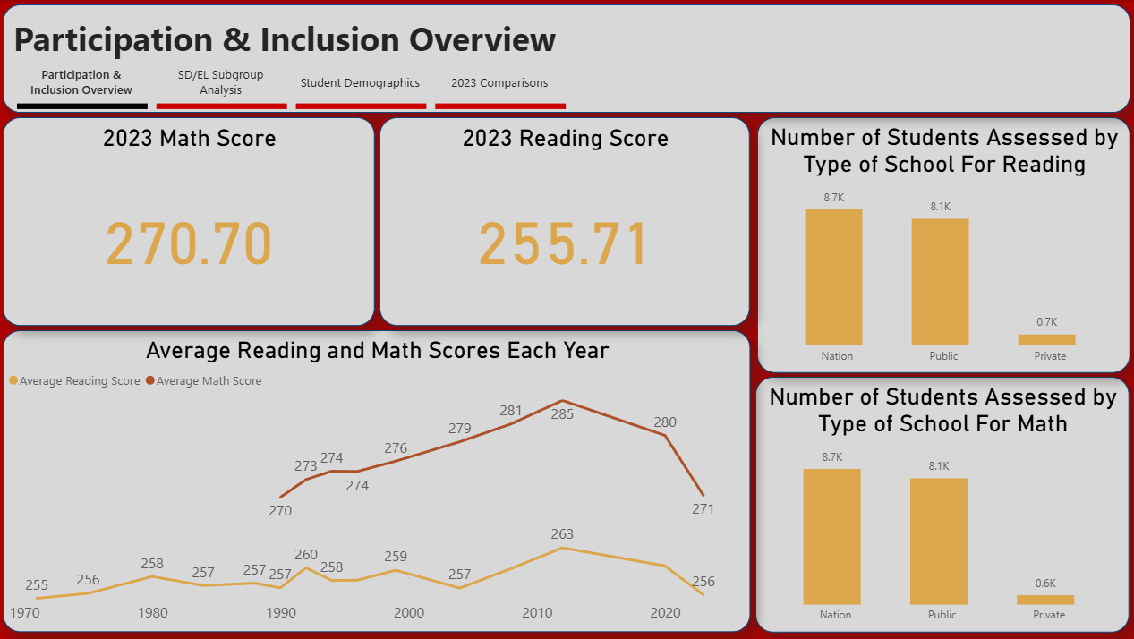
Participation & Inclusion Overview
This page gives a general overview of the data to better understand the following dashboard pages.
The 2023 Math and Reading Scores are the newest scores presented in the data and act as a basis for the rest of the data.
The bar graphs show which schools the data came from. National and Public schooling far outweighs private schools.
The average reading scores through the years has had little variation since the start of the data in 1970 other then an increase from 2003 until 2012. Since 2012 both Reading and Math scores have drastically decreased.

Slide 3
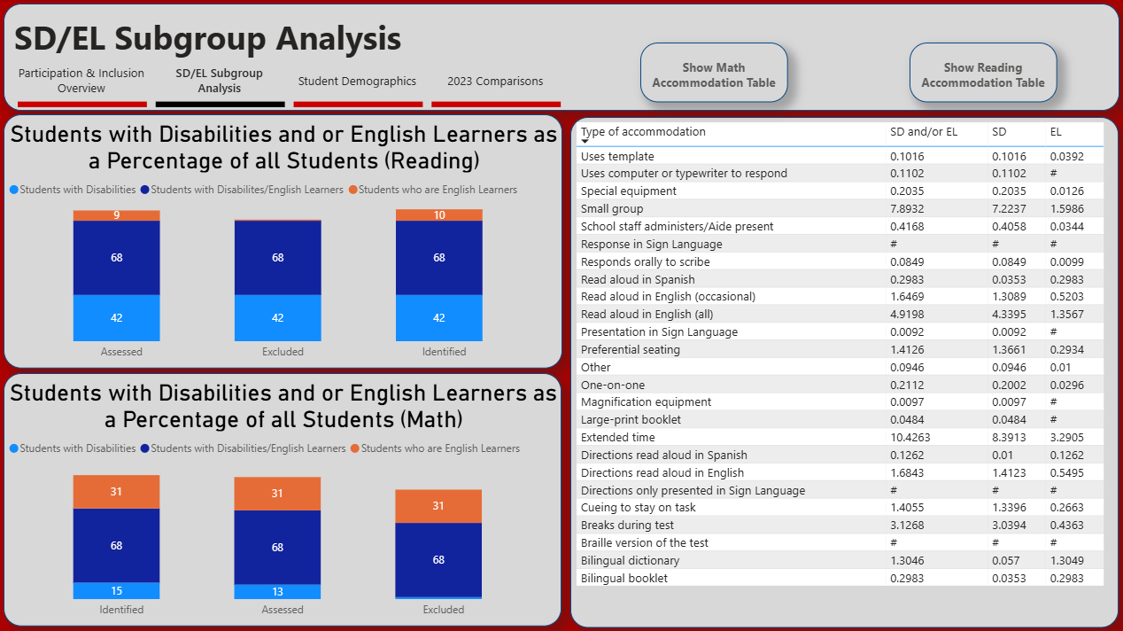
SD/EL Subgroup Analysis
This dashboard analyses the number of students who have disabilities or are English learners.
The stacked bar charts show the students who are disabled as a percentage of all students.
Students who had a disability, including those who were also English learners, were excluded from the dataset.
Students who were English learners were excluded from the math dataset but students who had a disability were retained.
The table to the right shows the various accommodations used during math testing with students who are disabled or are English learners.

Slide 4
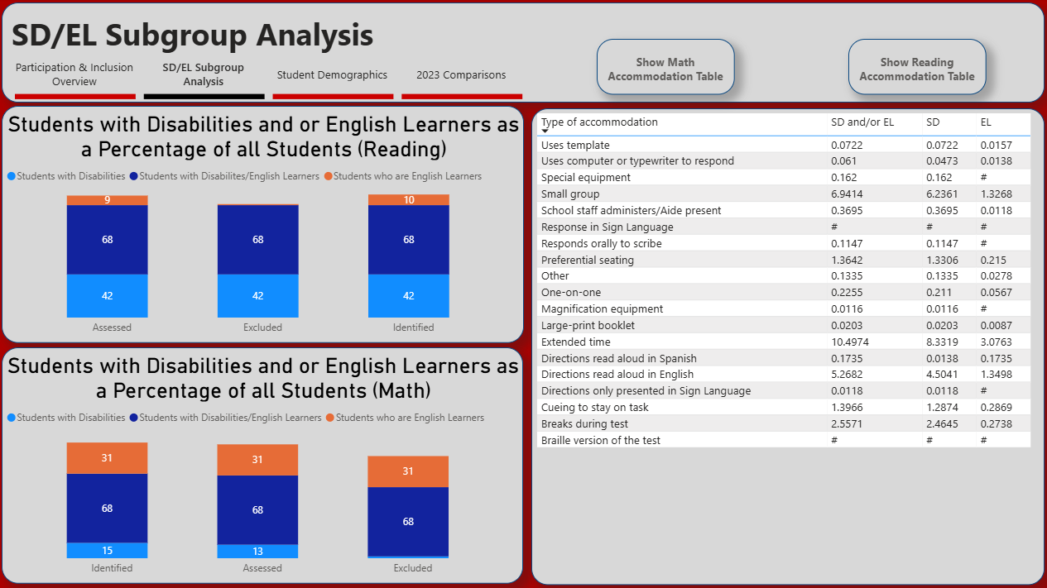
SD/EL Subgroup Analysis CONT.
The table to the right shows the various accommodations used during reading testing with students who are disabled or are English learners.

Slide 5
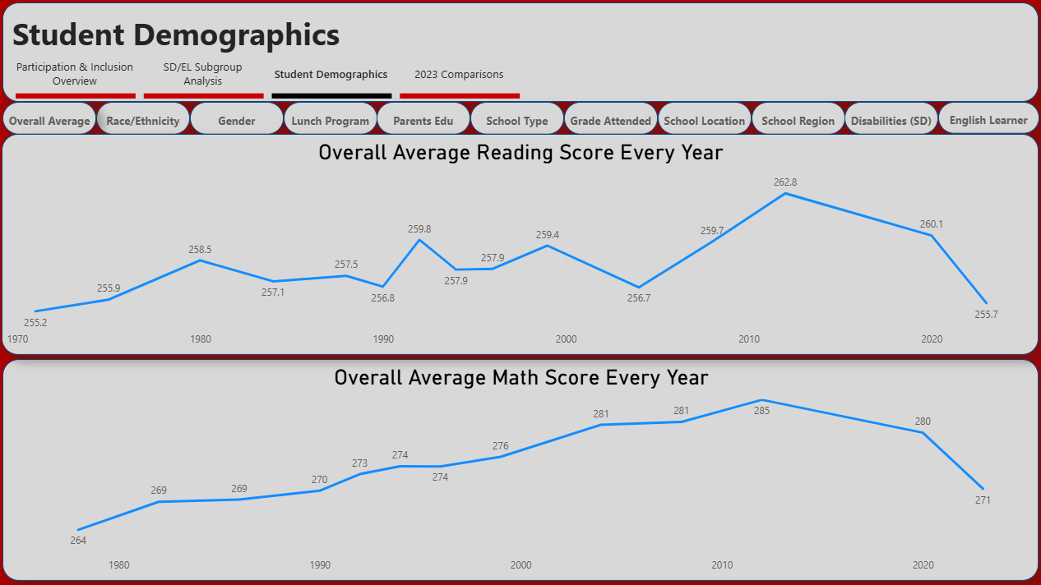
Student Demographics
This dashboard shows a number of line graphs based on various student demographics. Each are viewable by clicking on the buttons at the top of the dashboard.
Starting with the average reading and math scores very year gives a basis to compare the rest of the data to.

Slide 6
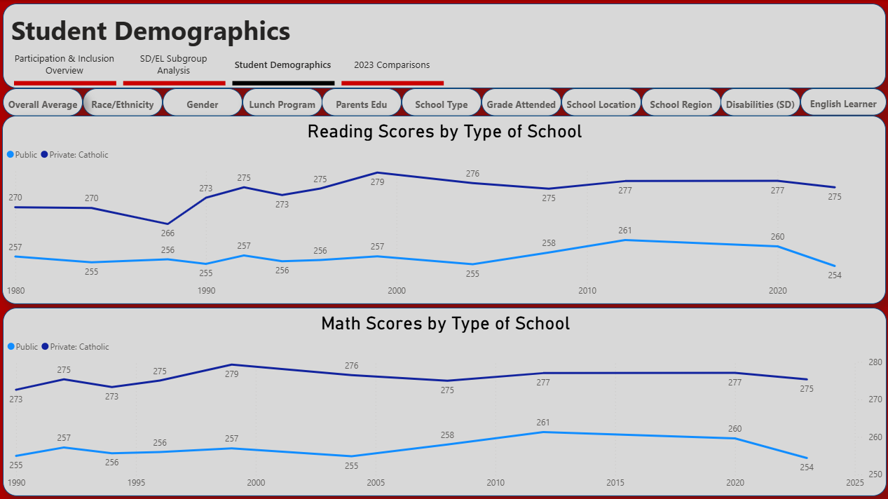
Student Demographics Cont.
Test scores for both reading and math are drastically higher in private schools as compared to public schools.
Though it is important to know that, as seen on the overview dashboard, there is not a large enough volume of private schools to have a meaningful effect on the national average.

Slide 7
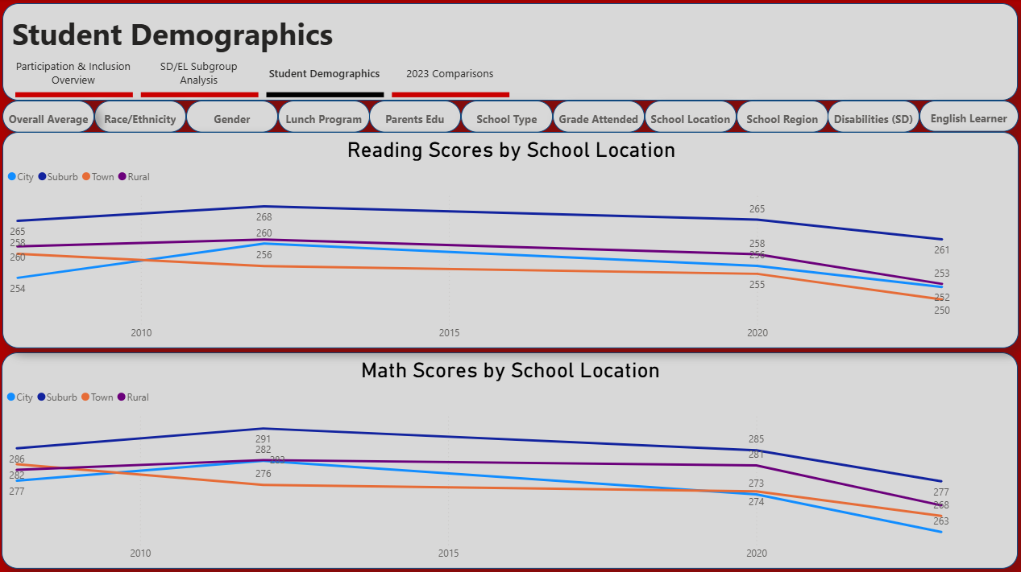
Student Demographics Cont.
Students who go to school in suburbs do far better in both reading and math testing.
Students who go to school in towns test the lowest in reading but cities test the lowest in math.

Slide 8
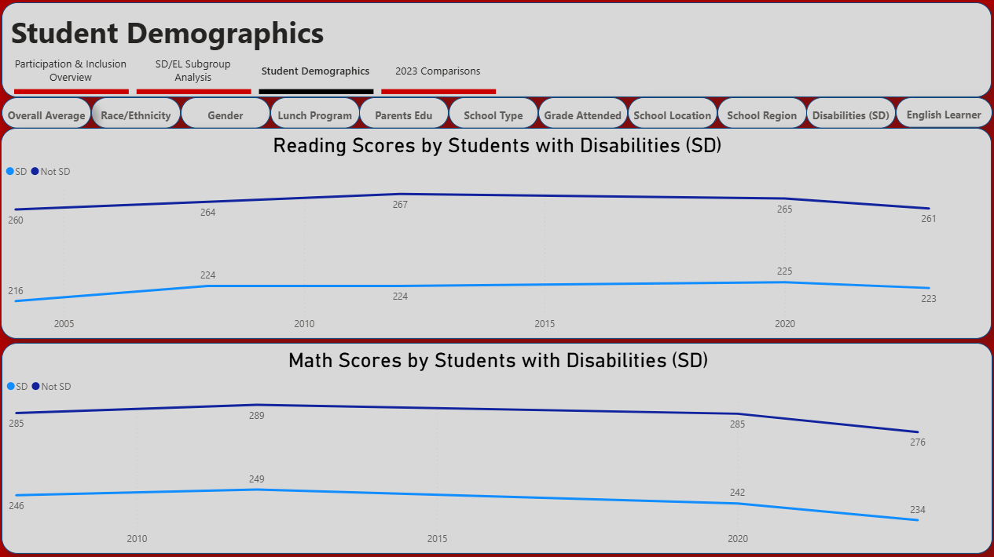
Student Demographics Cont.
Students who are disabled do far worse on both reading and math testing. This also includes disabled students who receive accommodations during their testing.

Slide 9
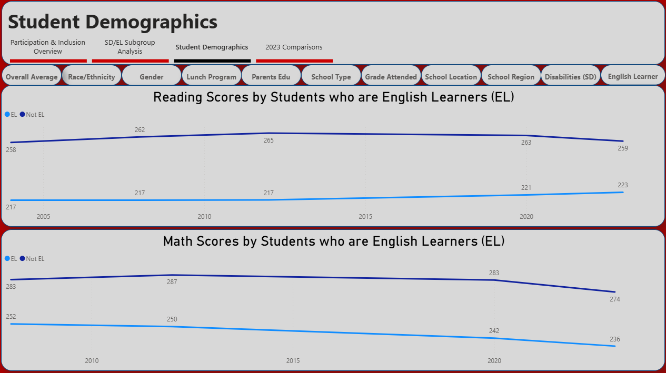
Student Demographics Cont.
Students that are English learners expectedly do far worse than those who are not on reading tests. Surprisingly, English learners have a similar if not larger gape with math scores.

Slide 10
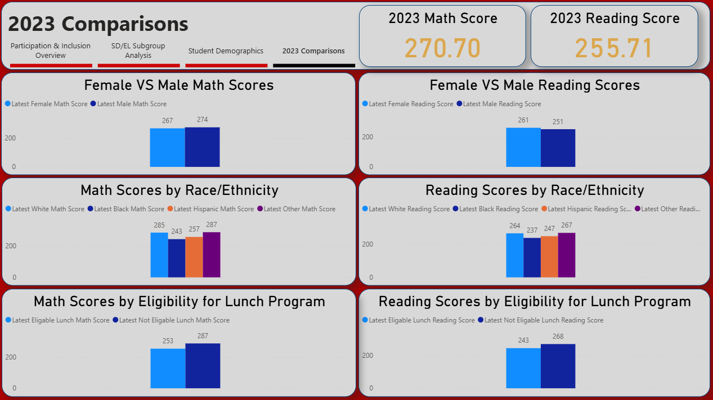
2023 Comparisons
This dashboard shows comparisons on various demographics in 2023.
The average 2023 scores for math and reading are reiterated at the top of the page for easy access.
Female and male students do have differences in there testing scores, but it is not enough to be significant.
The Race/Ethnicity bar charts show “Other”, which based on the ethnic makeup of America, contains primary Asian ethnicities has a large gap when compared to Hispanic and black students. White students are also close to “Other” with the same gap when compared to black and Hispanic students. This is seen in both reading and math scores.
Students who are not eligible for the National School Lunch Program are more likely to score high on reading and math tests. This indicates that poor students preform lower when compared to students who are not.

